Slide 1

JARVIS - AI Assistant:
Text & CODE Generation
A powerful tool combining text, image, and file analysis capabilities, built using Flask, Python, and OPEN AI API.

Slide 2
Introducing the JARVIS AI Assistant
Text and code Processing
Image Analysis
JARVIS can process text, translate languages, write different kinds of creative content, and answer your questions in an informative way.
JARVIS can analyze images, identifying objects, scenes, and emotions. It can also generate creative image variations.

Slide 3
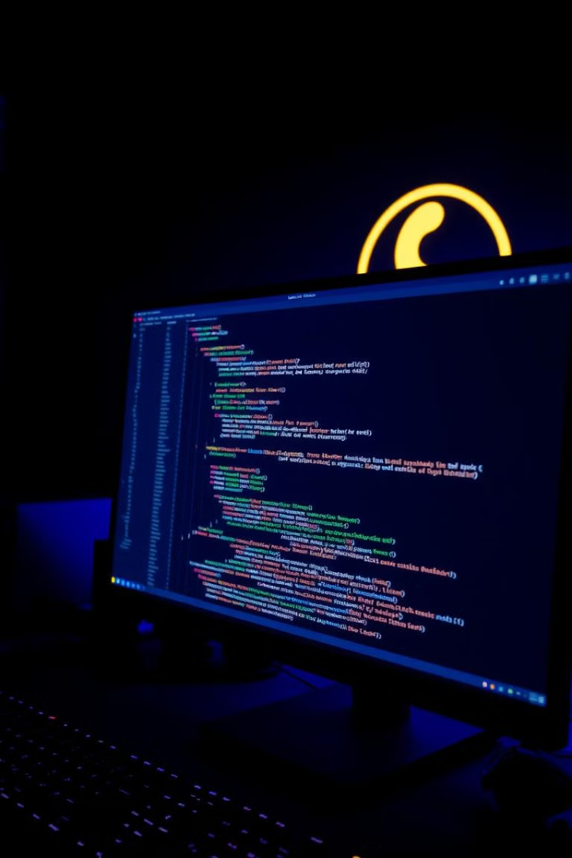
Tech Stack: A Powerful Foundation
Flask
Python
A lightweight Python framework for building web applications.
The language of choice for AI development, offering powerful libraries for data manipulation and analysis.
OPEN AI , ALIBABA API
PIL
The advanced AI engine powering JARVIS, providing text, image, and code generation capabilities.
Python Imaging Library, used for image manipulation and processing.

Slide 4
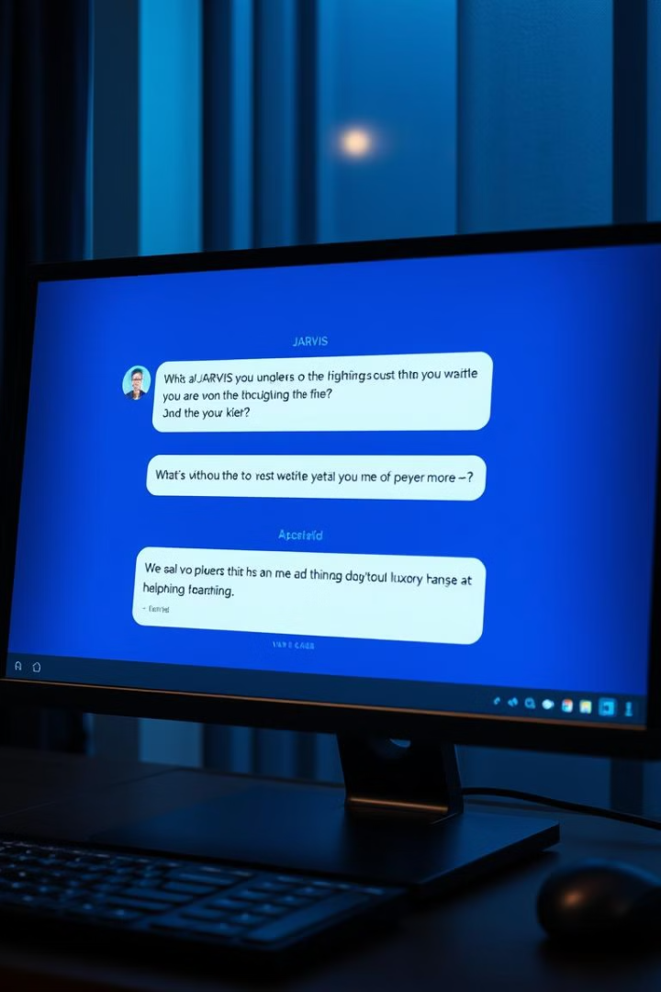
Text Response Generation
1
User Input
2
API Call
The user interacts with JARVIS by providing text input. It can be questions, prompts, or even code.
JARVIS sends the user input to the OPEN AI API, leveraging its advanced language model.
3
Response Generation
4
Display to User
The OPEN API generates a comprehensive and relevant response, based on the user's input.
The response is displayed to the user in a clear and concise manner, providing the desired information or assistance.

Slide 5





Application Architecture
User Interface
A web-based interface using Flask allows users to interact with JARVIS through a text input field.
Request Processing
Flask receives user input and processes it, including validation and sanitization.
API Integration
JARVIS communicates with the Gemini API through a secure API endpoint, sending the user input.
Response Handling
JARVIS receives the response from the Gemini API and formats it for display to the user.
Output Display
The formatted response is presented to the user through the web interface, offering text, images, or other outputs.

Slide 6





Challenges and Future Enhancements
Image Validation
Error Handling
Security
Performance
Ensuring that user-submitted images are valid and meet the requirements for processing.
Implementing robust error handling to gracefully manage unexpected events or API failures.
Protecting user data and ensuring secure API communication.
Optimizing code and leveraging caching to improve response times.

